Slide 1


Yanana Kitchens Co.
UTEK Consulting 2025 - Team 09
Image from Unsplash_{[17]}

Slide 2

Yanana Kitchens Co. is looking to expand beyond their existing 82 locations[1].
East Asian Casual Dining
67%
6%
Similar to Olive Garden, Red Lobster, Applebee’s, etc.
2%
9%
15%
Servers
Cashiers
Cooks
Management
2,800[1]
Employees
Location Distribution as of November 2024
This is ill-advised as Yanana Kitchens Co. currently has a 120% turnover rate in the past year[1].

Slide 3
These are some reasons for the low retention rate.
Employee exit surveys report…_{[1]}
Unhappiness with pay
Schedule inflexibilities
Lack of fulfilling
work culture
If employees aren’t satisfied then customer service quality decreases, negatively impacting Yanana Kitchen’s Co. brand image.

Slide 4
Employee satisfaction at Yanana Kitchens Co. is Low
We’re working to change that.
Decrease turnover rate
11% annual decrease
Starbucks is well-known for its employee satisfaction policies offering perks such as competitive pay and subsidized healthcare. It has a turnover rate 18% lower than the industry average of 83.4%. From 2022 to 2023, it decreased its turnover rate by 11%[2][3][4].
New Internal Policies
Easily scalable
Process standardized across all restaurants
Improved chain of command
Decrease hiring costs
$160,000 annual decrease
Yanana currently replaces 3360 employees annually at a rate of $447 per hire[1]. An 11% annual decrease in turnover reduces hiring costs by 175K in the first year alone and around 160K thereafter.
Notes:
We used starbucks as a benchmark…

Slide 5
New internal policies will help employees feel personally invested in their work.
New Internal Policies
Improved Chain of Command
Why It Matters
Decrease Turnover Rate
Increased benefits intended to keep employees satisfied which helps employees feel personally invested in the company
Full time employees are eligible for childcare and healthcare [8]
  At least 60 days after their employment start date
  Yanana will cover 50% of the fees
Full time employees are guaranteed unpaid time off on their birthdays
Full time employees get one week of paid time off [6]
Employees are mandated to take paid 10 minute breaks every shift
Consistent “Employee of the Month” Award
  Every 2 times an employee receives EOTM, they receive a 50¢ raise
Easily Scalable
Policies will be standardized throughout all locations so employees and customers get a consistent experience with Yanana Kitchens Co.
Decrease Hiring Costs
The hiring process occurs less which helps the company recover from the $1.5 million loss

Slide 6
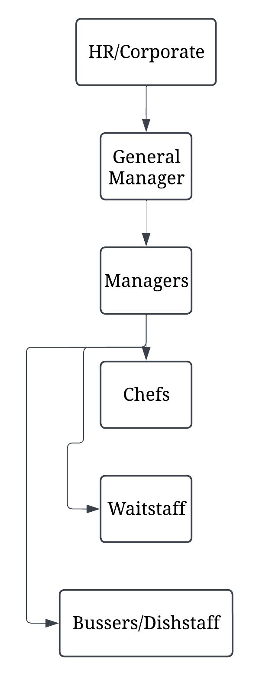
An improved chain of command helps globally
increase employee retention.
New Internal Policies
Improved Chain of Command
Why It Matters
Decrease Turnover Rate
Increased benefits intended to keep a balanced team dynamic
Cashier role removed
  Servers now process tabs
  Cashiers get rehired as servers
Increase part time staff
  More people to cover shifts
Increased and updated training [14]
Centralized App [15]
  Direct communication between management and employees
  Communication between local management and HQ
  Monthly schedule release
Easily Scalable
The number of employees per store can be scaled to fit the demographics of each specific location
Decrease Hiring Costs
Since the restaurant is a casual sit down experience, the cashier role can be filled by the server, cutting hiring requirements

Slide 7
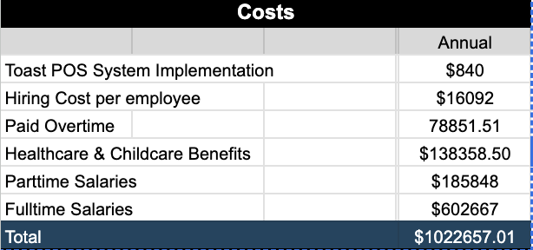
Increasing employee benefits generates long-term returns.
According to Boston Consulting Group, including healthcare and child care in employment packages is an investment[8].
01
02
Increases retention rates
Decreasing hiring cost
Facilitates scouting
03
Tax savings return from Health & childcare Benefits: $36,045.21
Total annual operational costs: $1,022,657.01
Notes:
-Remember cost calculations from my notebook and appendix
- “With these added benefits in place, annual operational costs will be at $1022657.01”
‌

Slide 8
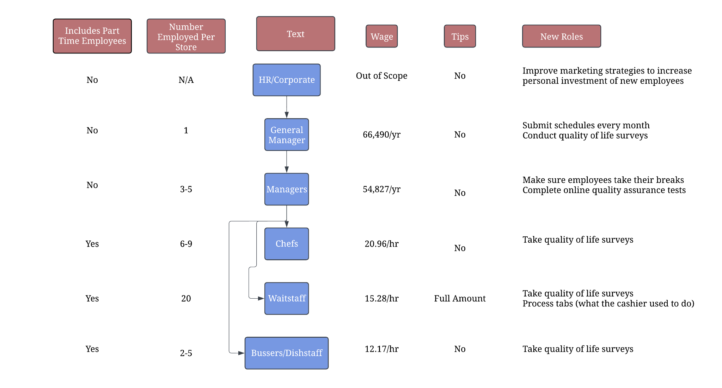
Funds saved from reducing hiring costs will be reinvested in increasing employee wages based on seniority.

Slide 9
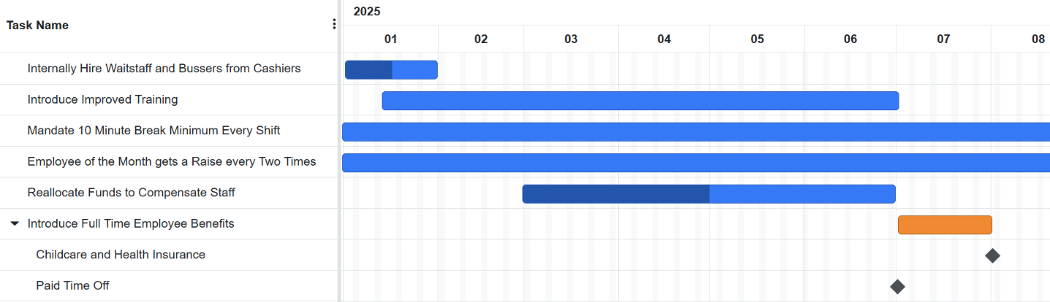
Implementing this plan is feasible within 12 months per location.
Gantt chart continues as is
Based on the average sized store
Easily scaled to smaller locations
Buffer factor included so larger locations can catch up

Slide 10
Long term reliability is crucial in improving employee and customer satisfaction with Yanana Kitchens Co.
Marketing
Improved Training [14]
Advertise long-term employment benefits
  Increasing personal investment
  Career with the company
Training routines update and adapt to company growth
  Surveys will help improve internal benchmarking
Scheduling
Quality Assurance
Employers send out schedules for a month at a time
  Consistency and organization
Weekly surveys submitted to HQ
  Ensure policies are being followed
  Maintenance checks
Notes:
These practices will ensure that turnover rates continue on a downward trend after solution implementation.

Slide 11
References
[1] E. Y. Zhu, Toronto, Ontario, 2025
[2] Starbucks, “our ENVIRONMENTAL & SOCIAL IMPACT report S T A R B U C K S 2 0 2 2 our ENVIRONMENTAL & SOCIAL IMPACT report,” 2022. Available: https://stories.starbucks.com/uploads/2023/05/2022-Starbucks-Global-Environmental-Social-Impact-Report.pdf
[3] Progress report data tables, https://stories.starbucks.com/uploads/2024/02/2023-Starbucks-Global-Impact-Report-Partner-Data-Tables.pdf (accessed Jan. 18, 2025).
[4] “What is the Average Restaurant Industry Turnover Rate for Employees?,” Toasttab.com, 2024. https://pos.toasttab.com/blog/on-the-line/restaurant-turnover-rate (accessed Jan. 18, 2025).
[5] Bricker Graydon LLP, “The 90-Day Waiting Period Prohibition Applies to All Employers Regardless of Your Size,” @BrickerGraydon, Nov. 28, 2016. https://www.brickergraydon.com/benefits-insights/90-day-waiting-period-prohibition-applies-employers-regardless-size?utm_source=chatgpt.com (accessed Jan. 18, 2025).
‌
[6] “What’s the Average Paid Time Off (PTO) in the United States?,” Trinet.com, 2023. https://www.trinet.com/insights/how-much-is-average-pto-in-the-us (accessed Jan. 18, 2025).
[7] “Section 1: Cost of Health Insurance - 10240 | KFF,” KFF, Dec. 08, 2023. https://www.kff.org/report-section/ehbs-2023-section-1-cost-of-health-insurance/?utm_source=chatgpt.com (accessed Jan. 18, 2025).
[8] E. Kos, K. Clark, N. D. Santis, and T. Joseph, “Childcare Benefits More Than Pay for Themselves at US Companies,” BCG Global, Mar. 26, 2024.
https://www.bcg.com/publications/2024/childcare-benefits-pay-for-themselves-at-us-companies (accessed Jan. 18, 2025).
[9] K. Zhu, “Mapped: Infant Child-Care Costs by U.S. State,” Visual Capitalist, Oct. 03, 2024. https://www.visualcapitalist.com/mapped-infant-child-care-costs-by-u-s-state/?utm_source=chatgpt.com (accessed Jan. 18, 2025).
[10] “Applebee’s Careers and Employment,” Indeed.com. https://www.indeed.com/cmp/Applebee
[11] “Hourly salaries in the United States at Red Lobster,” Indeed.com. https://www.indeed.com/cmp/Red-Lobster/salaries/Chef
[12] “Yearly salaries in the United States at Olive Garden,” Indeed.com https://www.indeed.com/cmp/Olive-Garden/salaries/Service-Manager
[13] “Yearly salaries in the United States at IHOP,” Indeed.com https://www.indeed.com/cmp/Ihop/salaries/General-Manager
[14] E. Rosenbaum, “Panera is losing nearly 100% of its workers every year as fast-food turnover crisis worsens,” CNBC, Aug. 29, 2019. https://www.cnbc.com/2019/08/29/fast-food-restaurants-in-america-are-losing-100percent-of-workers-every-year.html (accessed Jan. 18, 2025).
[15] A Living Wage, "A Living Wage," Hamilton Roundtable for Poverty Reduction. [Online]. Available: https://hwtc.ca/a_living_wage/#:~:text=When%20workers%20are%20paid%20a%20living%20wage%2C%20they%20are%20more,are%20satisfied%20with%20their%20experience. (Accessed: Jan. 18, 2025).
[16] 7shifts, "Restaurant Scheduling, Payroll & Retention tools," 7shifts, 2025. [Online]. Available: https://www.7shifts.com/. (Accessed: Jan. 18, 2025).
[17] M. Markes, “table of round food containers,” Unsplash.com, Feb. 2018. https://unsplash.com/photos/table-of-round-food-containers-lfgsLxX17QA (accessed Jan. 19, 2025).

